Slide 1

Candy Rush Grand Prix
By: Trevor Hicks

Slide 2
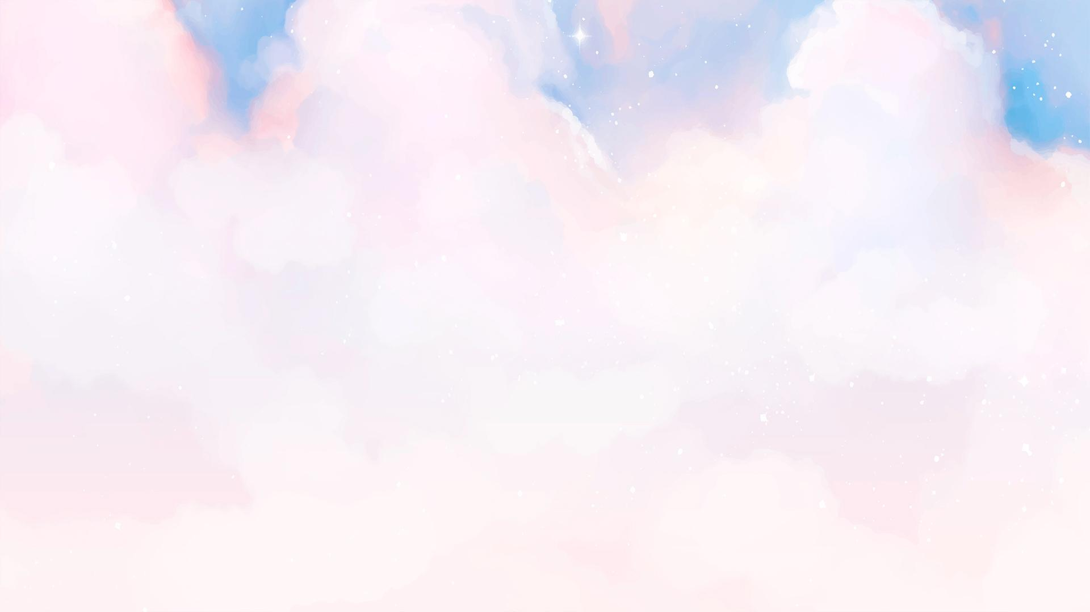
Can a video game satisfy your sweet tooth and your need for speed?
"Candy Rush Grand Prix" is a candy-themed go-kart racing game inspired by Mario Kart. Players race through whimsical, sugar-filled environments, navigating tracks made of chocolate, licorice, and other sweets. The game features colorful karts, candy power-ups, and fun, competitive gameplay, perfect for players of all ages.

Slide 3
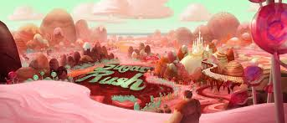
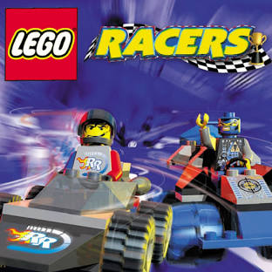
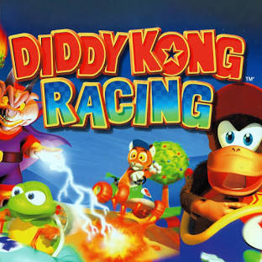
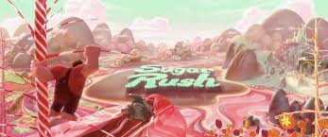
What Inspired Me?

Slide 4

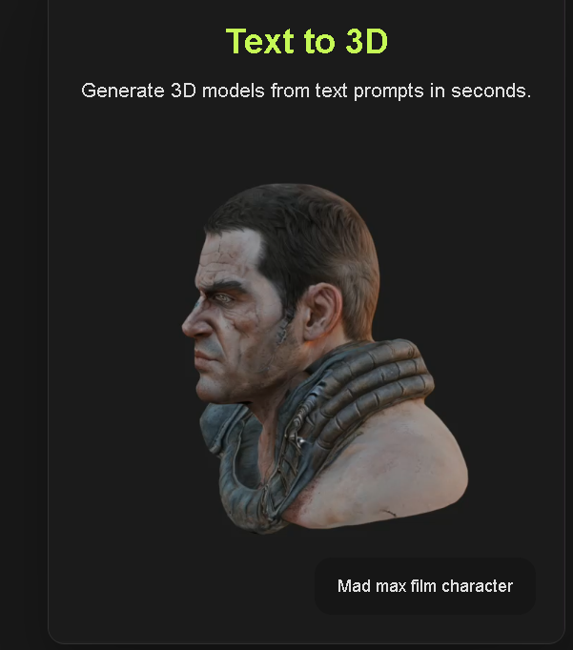

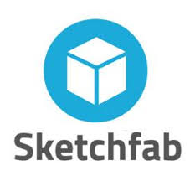

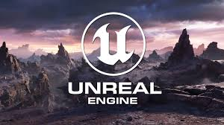
What I used?

Slide 5
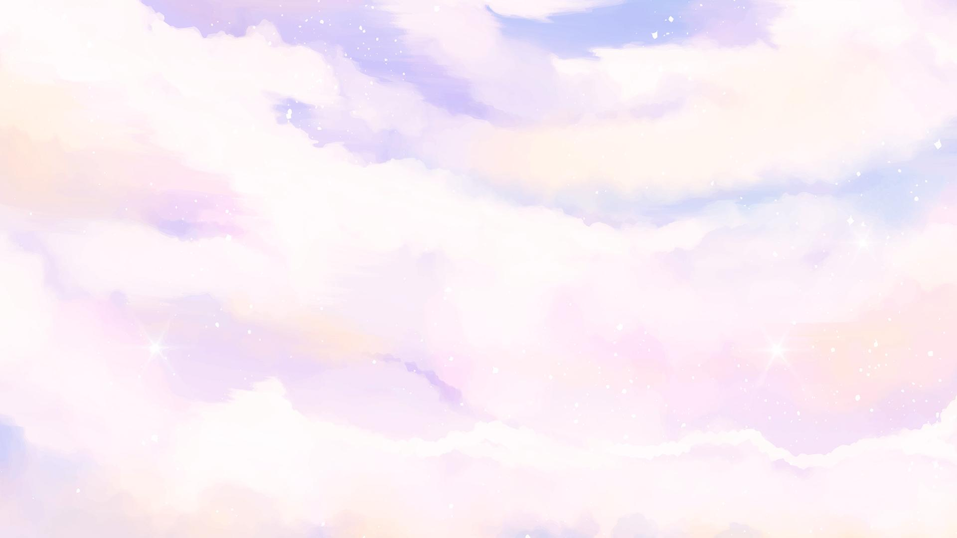
Demo

Slide 6
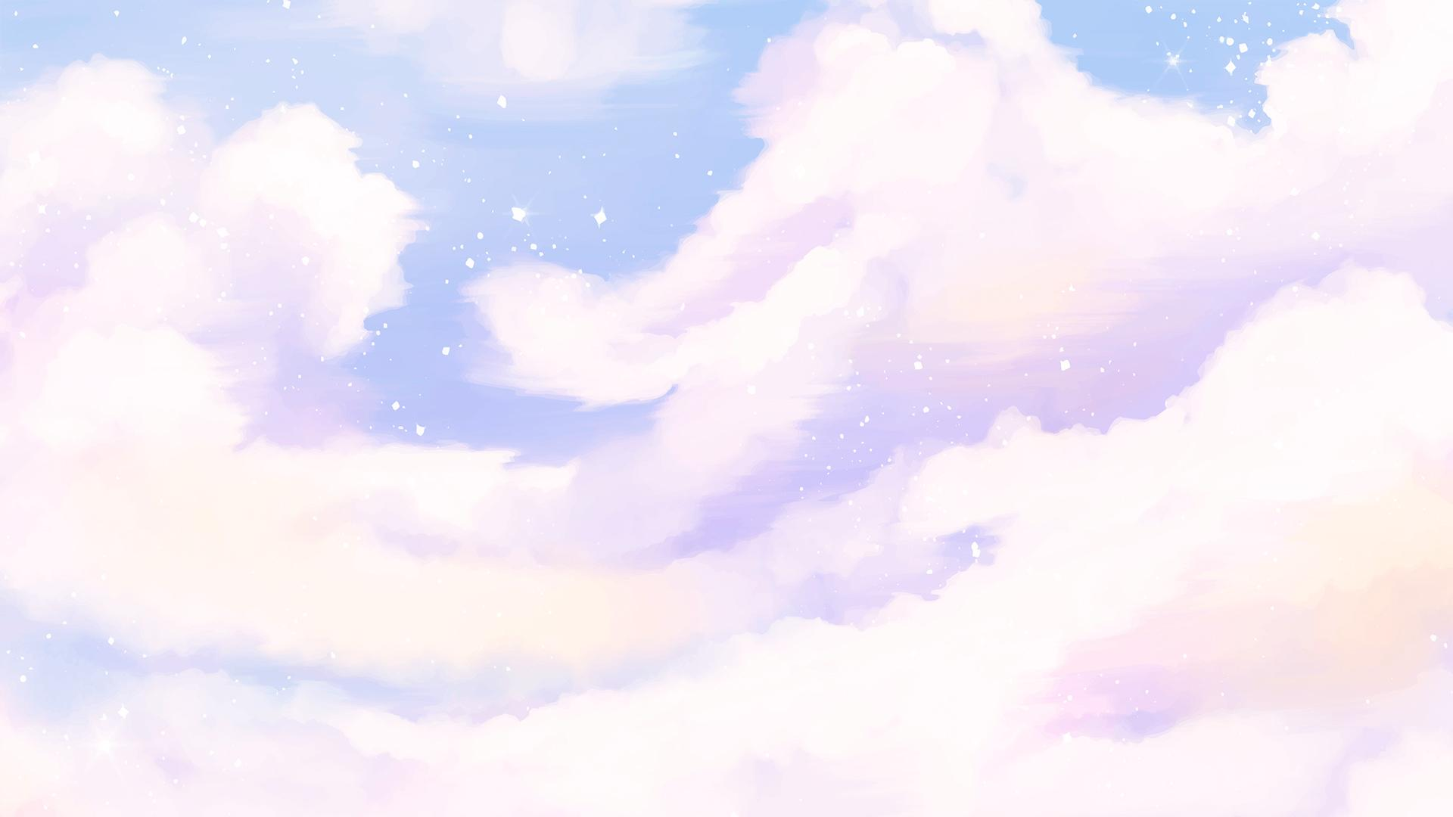
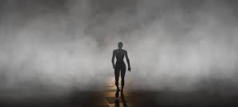
What didn’t work?
Passive Fog so players can move threw the clouds and the fog would disperse
GitHub Source Control Setup – at first it wasn’t working to setup but found a work around.
Track Design: track was fairly easy to make and setup but upon testing found track wasn’t connected and later on in development was able to make a fluid seamless track.
Initial problems with the lap counting system, causing laps not to register correctly or inaccurately tracking player progress
Challenges in balancing the power-ups to ensure fair and fun gameplay, as some abilities might have been too powerful or ineffective in early iterations

Slide 7
What I learned?
2 ways to make tracks (landscapes, and blueprint splines)
Making a looping video instead of a static menu
How to make and setup properly so they don’t fly off the track
Creating Options to handle sound and control them
Implementing Niagara FX for visuals into the items.

Slide 8

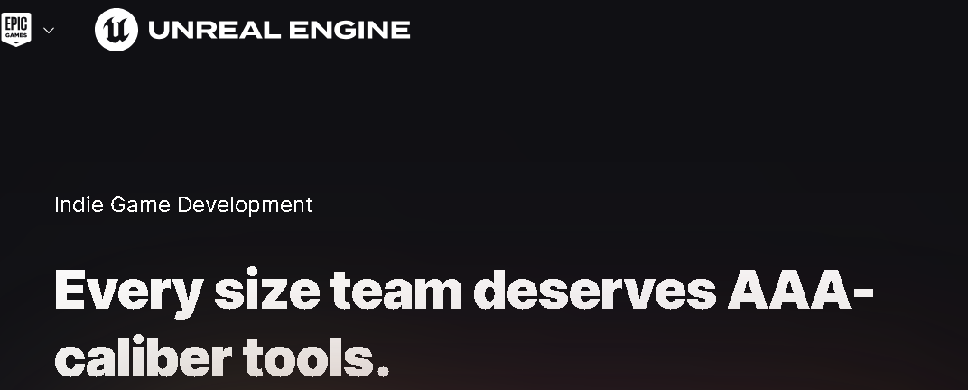
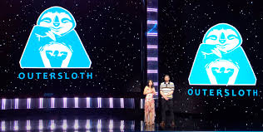
Future Plans
More Items
Bring back Battle Arena’s and secret track routes
Multiplayer / Couch Co-op
More Themed Tracks / Special Tracks during holiday times
More Customization to karts
Character Creation

